Slide 1
Mind Over Muscle
The Latest Research On Endurance And Performance
Craftsbury Academy XC - 2019

Slide 2
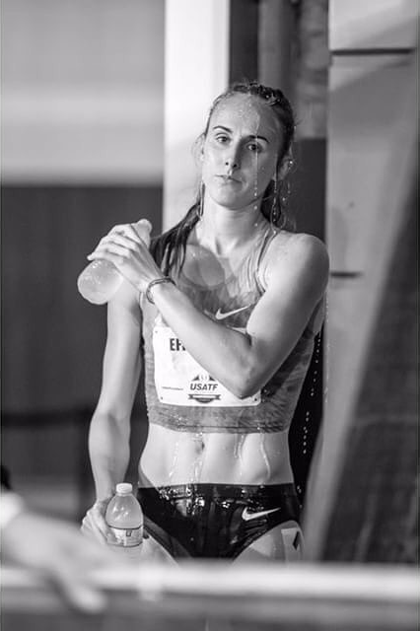
Overview
How Perception of Effort Limits Performance
5 Ways To Master Perception of Effort and Improve Performance
Are you a “Head Case” and What You Can Do About It!
Discussion

Slide 3
What We Now Know
Psychobiological Model of Endurance Performance
Human Endurance and Performance are NOT directly limited by physiology. Endurance and Performance are technically constrained by our physiology, but are limited – or more accurately – determined – by psychology and specifically by perceived effort.

Slide 4
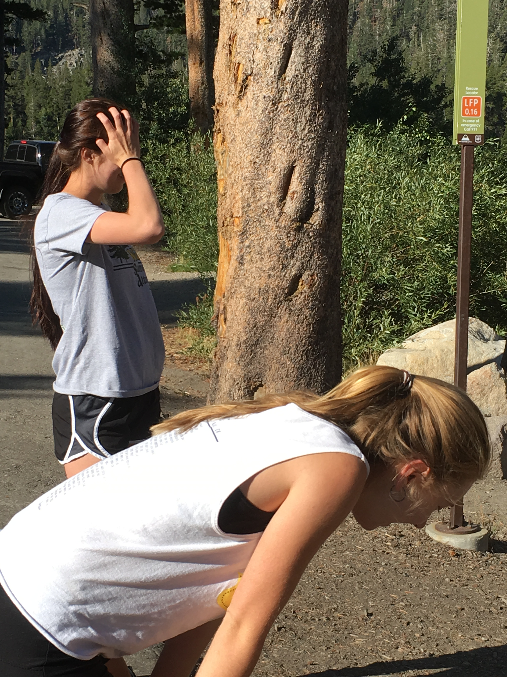
Open Loop Endurance tests
“Exhaustion (task failure) is not due to lactate accumulation and the associated muscle acidification; neither the aerobic energy pathways nor the glycolysis are blocked at exhaustion.”
“Although the maximal rate of ATP provision is markedly reduced at task failure, the resynthesis capacity remaining exceeds the rate of ATP consumption, indicating that task failure during an incremental exercise to exhaustion depends more on central than peripheral mechanisms.”
Calbert et al, 2015

Slide 5
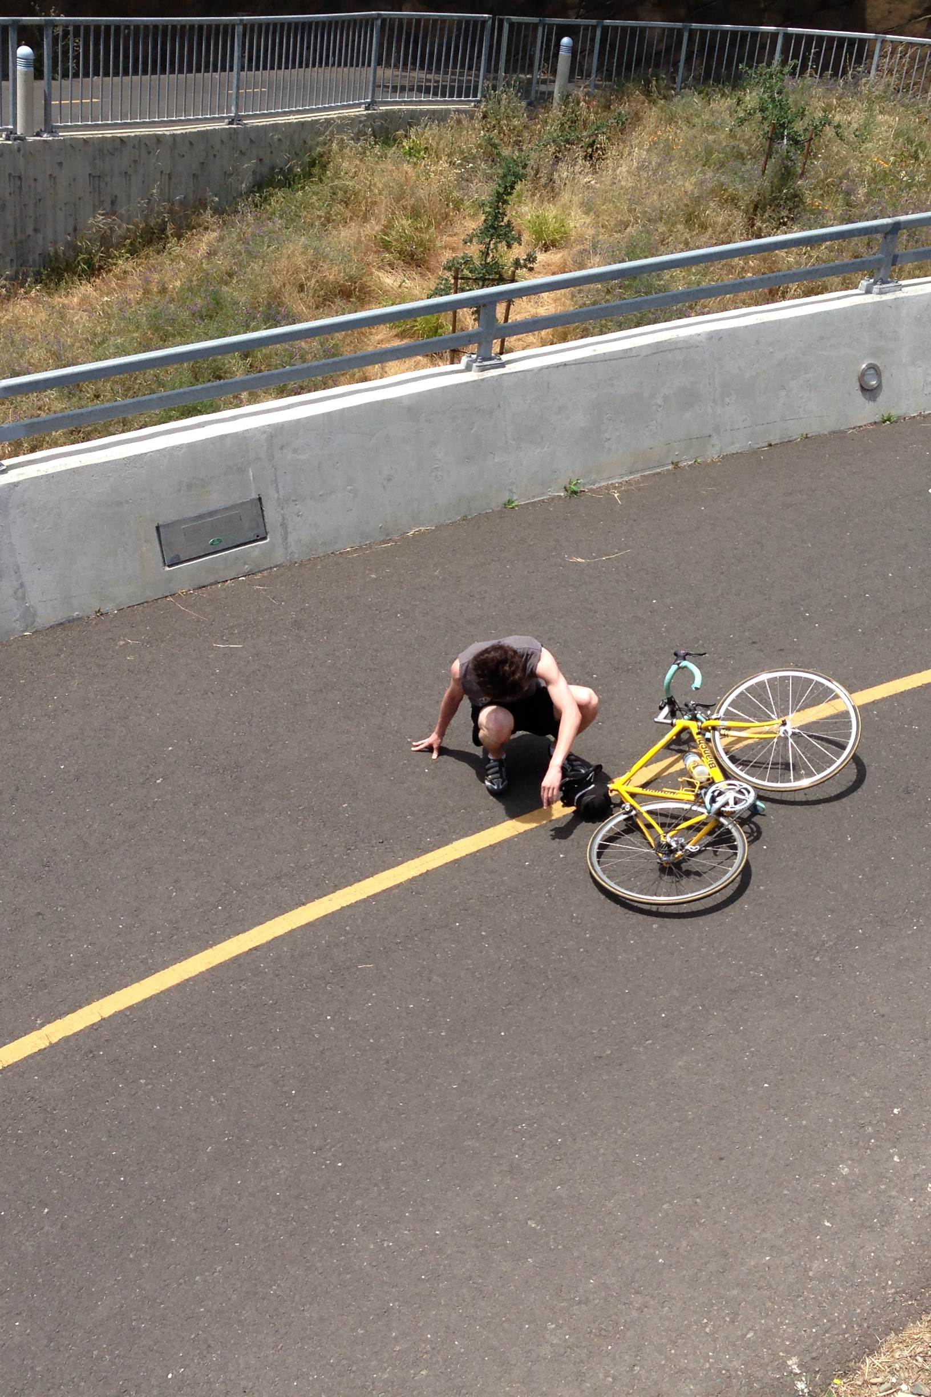
Reserve Functional capacity at “exhaustion”
Step 1: 5‐Second Max Power Output
1,075 watts
Step 2: Submaximal ride to exhaustion
242 watts
Step 3 (Surprise): 5‐Second Max Power Output
731
Marcora, et al, 2010, 2016

Slide 6
only one measurement is limiting at exhaustion
Blood lactate
Concentration
Muscle pH
Muscle cell depolarization
ATP depletion
Muscle glycogen depletion
Core body temperature
Perception of effort
People stop exercising NOT when they cannot continue any longer but when they FEEL they cannot try any harder.

Slide 7
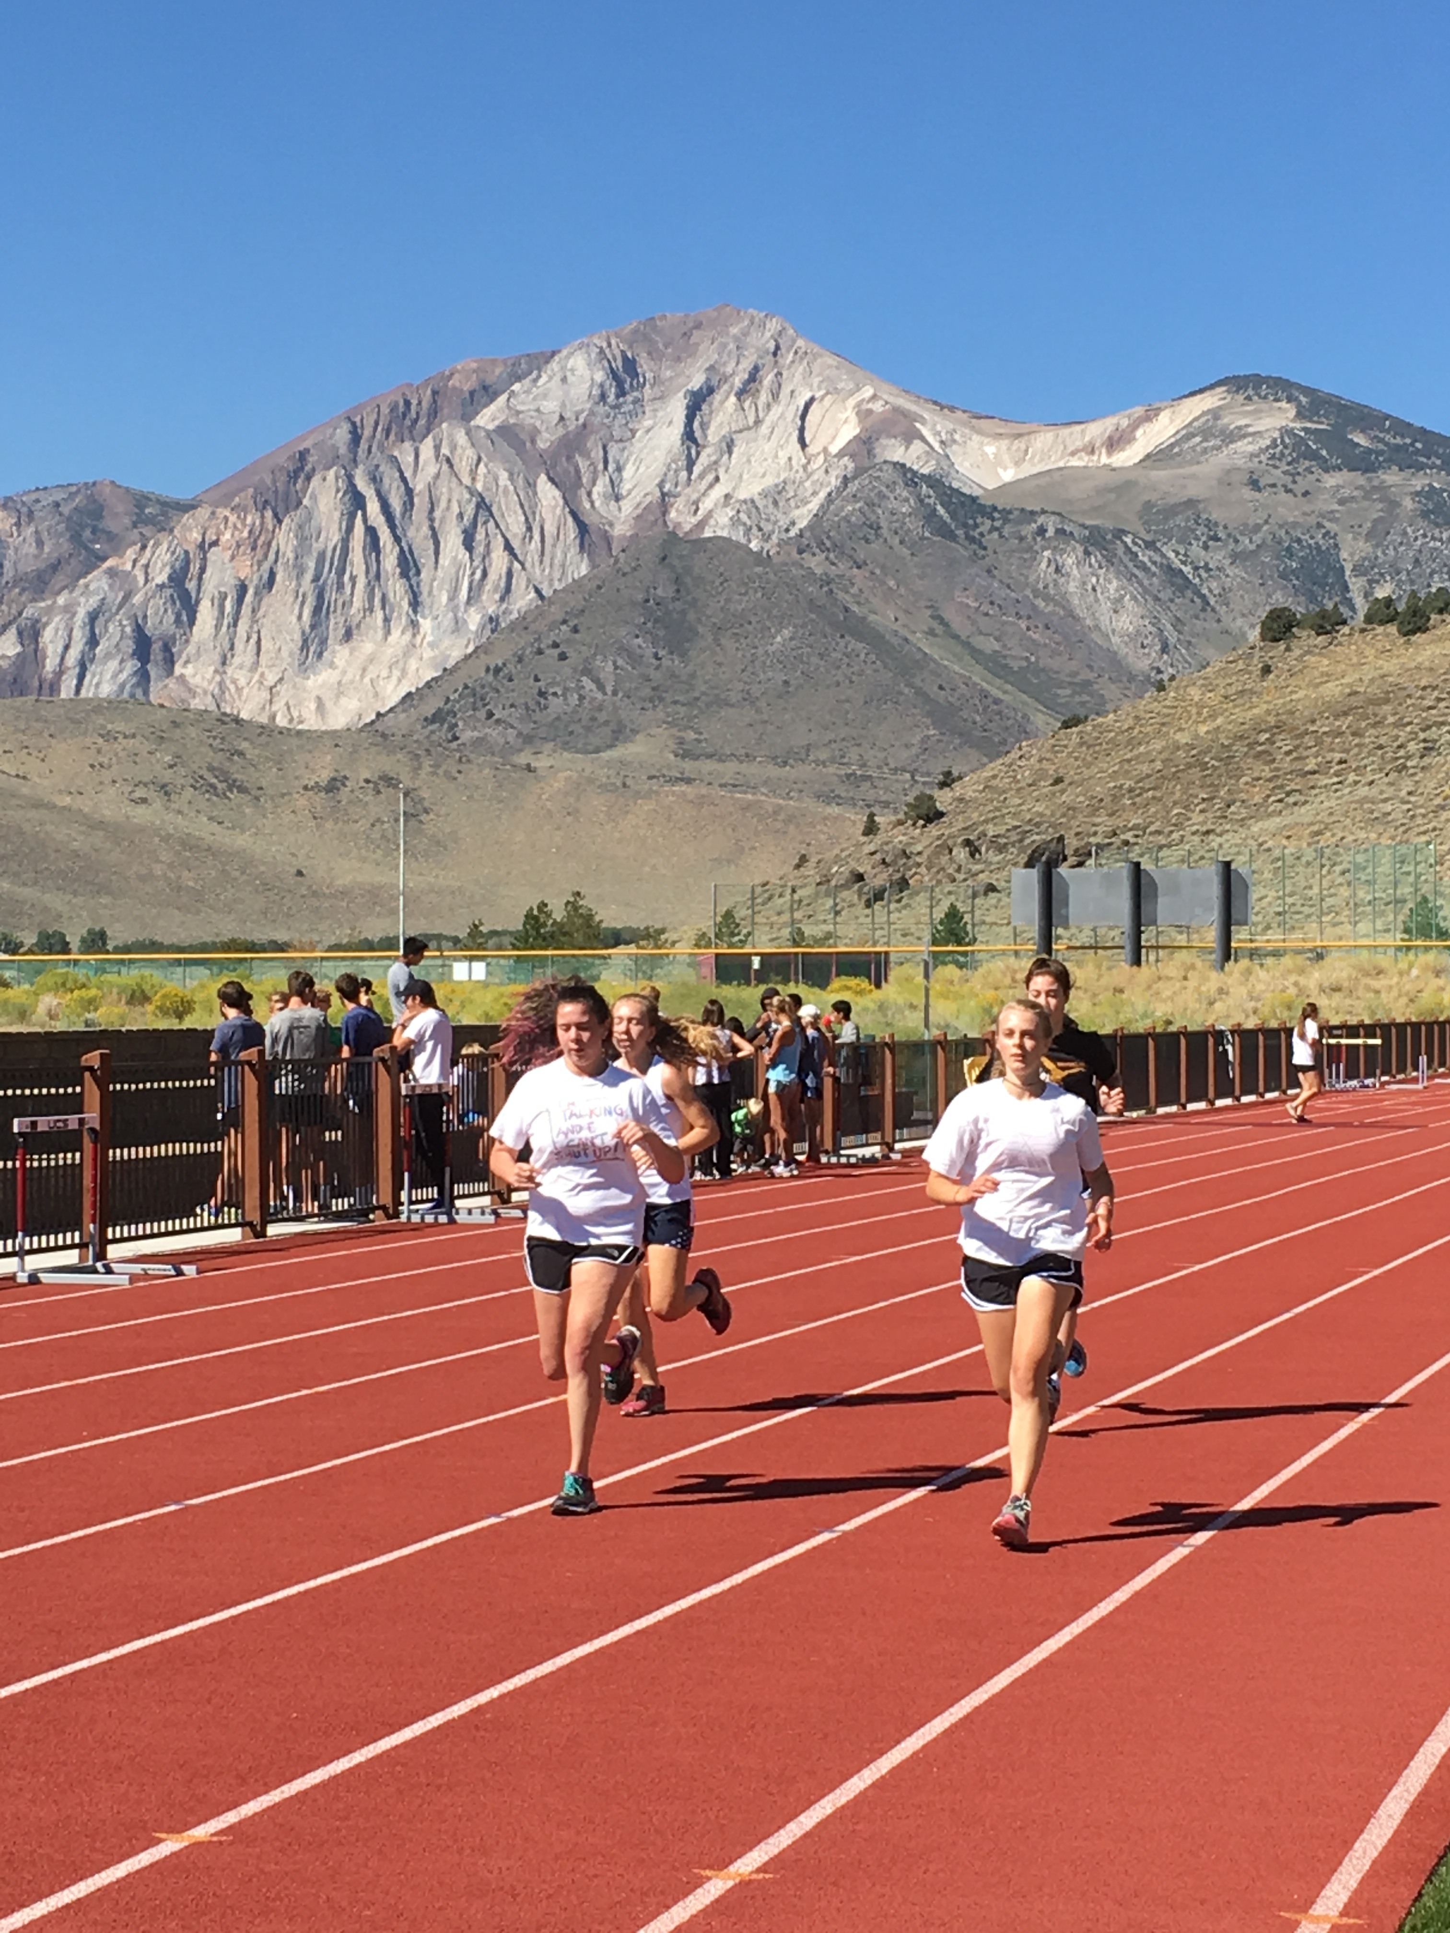
Closed Loop Testing
Maximum output (speed) cannot be sustained longer than 7‐9 seconds in running races.
All races lasting long than 30 seconds must be paced to ensure best outcome.

Slide 8
Pacing Perceived Effort
Cyclists optimize
performance in a time
trial of unknown distance
after four tries.
Mauger et al, 2009
Rate of perceived effort
increase predicts endpoint
in multi‐lap mountain bike
Race.
Viana et al, 2016

Slide 9
The 2 Ways A Runner Can Improve
Increase Maximum Perceived
Effort Tolerance
Motivation
Experience
Anger
Etc.
Reduce Perceived Effort at Any
Given Pace
Training
Caffeine
Group Effect
Etc.

Slide 10
5 Ways to master perception of effort

Slide 11
1. Set 50/50 goals
Muscular Endurance Test
Ranking of Improvement by Goal Type
1. Difficult/Realistic (20%)
2. Easy (10%)
3. Improbable/Unattainable (40%)
4. Subjective (“Do your best”)
Bar‐Eli et al., 1997

Slide 12
2. Trust The system
Performance in 5 km Time Trial
Hurst et al., 2013
Control Condition Placebo Condition
20:16 19:55
“Believe in your system, and
then sell it to your players.”
‐‐Billy Donovan

Slide 13
3. Practice Feel-Good training
 | Time Trial Watts | RPE at 200 Watts
2 Weeks Normal Training | 261 | 9.2
2 Weeks Intensified Training | 239 | 10.9
2 Weeks Recovery Training | 265 | 8.5

Slide 14
Feel-Good Training Continued
Ceci et al, 1991
Runners go faster at
same RPE outdoors
St Clair Gibson, 2012
Difference between good an bad workouts is affective

Slide 15
4. Think helpfully
Positive Self‐Talk Training Enhances Endurance Performance

Slide 16
5. Brace yourself
“This is going to be the hardest
race of my life.”
Acceptance Vs. Suppression

Slide 17
I’M a “head case”!
What can I do?
Step 1: Acknowledge the
problem and make it an
explicit goal to overcome it.
Step 2: Try things
Toughness training
Qualitative race goals
Letting “off the hook”

Slide 18

Questions/discussion

