Slide 1
Preparing To Compete
Craftsbury Academy Cross Country 2019

Slide 2
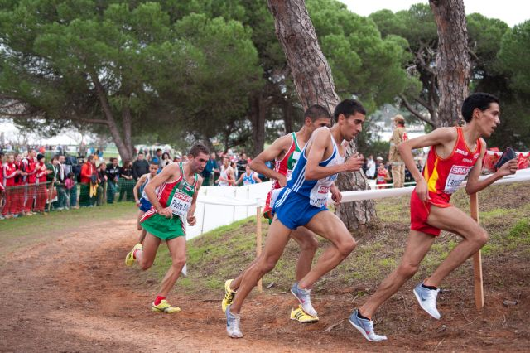
Make This YOUR Season

Slide 3
Preparing for Competition
Laying and preserving the foundation for success.
Sound, intelligent training addressing all facets of the race
Throughout the season
1 or 2 days before the event
Race Day
Post Event
Physical & Emotional Cool Down
Race Assessment
Early Season vs. Competitive Season
Notes:
How presentation will benefit audience: Adult learners are more interested in a subject if they know how or why it is important to them.
Presenter’s level of expertise in the subject: Briefly state your credentials in this area, or explain why participants should listen to you.

Slide 4
Excellence!
“We are what we repeatedly do.
Excellence, then, is not an act,
but a habit”
Aristotle
Notes:
Lesson descriptions should be brief.

Slide 5
Laying The Foundation For Success
Training Plan
Academic Plan
Rest/Sleep Plan
Nutrition Plan
Support Network
Team
Notes:
Example objectives
At the end of this lesson, you will be able to:
Save files to the team Web server.
Move files to different locations on the team Web server.
Share files on the team Web server.

Slide 6
Bricks In The Foundation
Physical Training
Endurance
Strength
Flexibility
Balance
Nutrition
Planned Rest
Sleep Management

Slide 7
Have a Nutrition/Hydration Plan
At Home
At School
Before the workout
After the workout
Snack plan

Slide 8
Take Ownership Of Your Training Plan
Always Think of Your Plan and Your Goal
Steady State Runs, Interval Training, Pace Work, Speed Work
Running Mechanics
Passive Energy Gains
Competitive Drills
Train Smart

Slide 9
Train Smart Recovery is just as important as intense training
Common Sign Of Inadequate Care In The Rest Phase
Always feel tired (after the first 3 weeks)
Soreness/aches that will not go away
Unable to sleep well
Irritated all the time

Slide 10
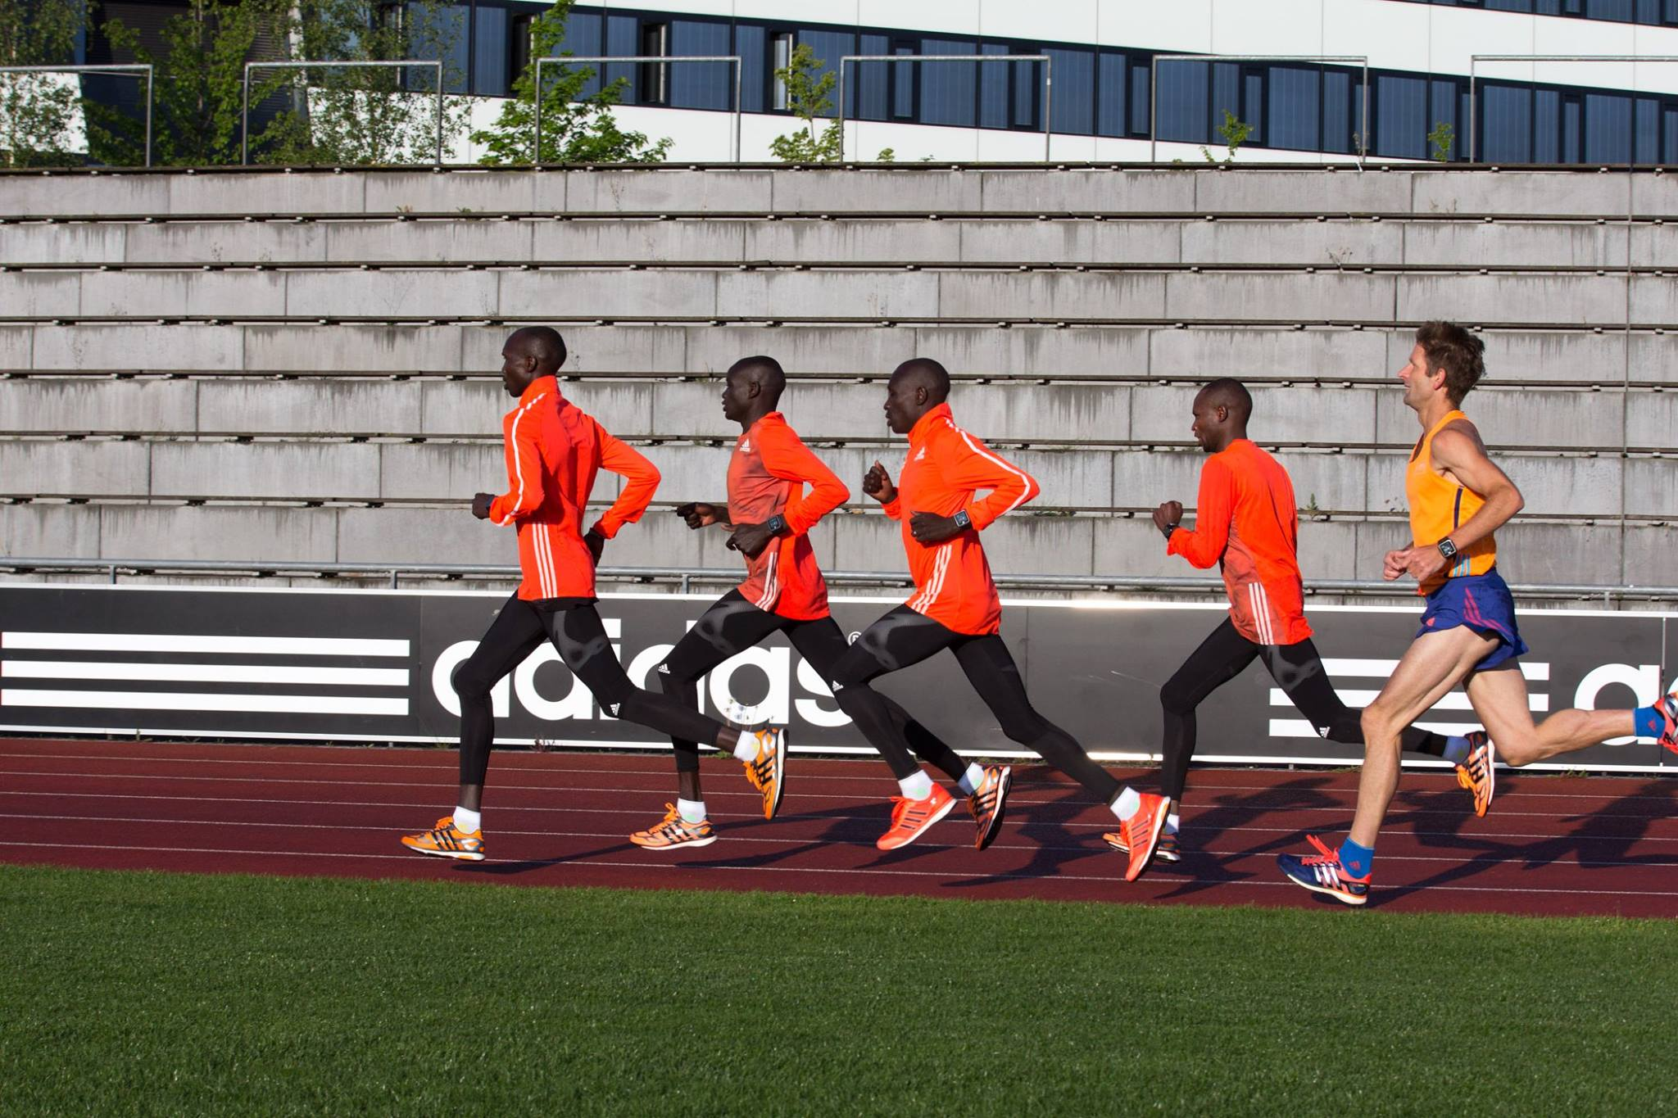
Preparation Creates Success

Slide 11
Preparing For Competition Throughout The Season
1-2 days before the meet
Race Plan (Training through)
Tactics
The night before the meet
Pack – lay our race gear
Mental Preparation/Visualization
Rituals
Do everything with care and deliberation

Slide 12
Race Day
Pre-race meal
Travel plan and timing
Timing of warm up
Plan A – B – C
Post race evaluation and Honest race assessment
Do everything with care and deliberation

Slide 13
Concluding Thought
“Motivation is what gets
you started.
Habit is what keeps
you going.”
Jim Ryan

